Slide 1
Scholarship Admin Training Academic Year 2023-2024

Slide 2
Office of Student Financial Assistance
Kris Shewmaker, Associate Director for Scholarships
Taylor Richter, K-State Scholarship Network Coordinator
Tamara Moots, Scholarship Specialist

Slide 3
KSU Foundation
Christy Scott, Associate Vice President of Compliance Services
Pam Collins, Director of Compliance Services
Anani Eble, Donor Compliance Manager
Katy Walradt, Fund Utilization Manager
Karen Dunn, Compliance Services Specialist
Tony Webb, Donor Compliance Specialist

Slide 4
Fund Types
Expendable funds
Not invested in endowment pool
Monies available for spending immediately
Endowed funds
Effective July 1, 2023, Minimum contribution of $50,000
Principal/corpus invested in endowment pool for perpetuity (cannot be invaded)
Percent (amount approved annually) of market value distributed for use by campus quarterly
Term-endowed funds
Principal/corpus invested in endowment pool
Principal can be invaded
Percent (determined by donor) or designated amount of market value distributed for use by campus quarterly

Slide 5
KSUF MOUs
An MOU is a binding agreement that documents donor intent for a fund.
MOU and their supplemental documents, contain the information needed to:
Establish donor intent for awarding
Is used to build Qualifications in KSN
Which generates the opportunity’s applicant pool
Preferences:
Donor’s expectation that preferences are honored
If easily met, we build as a requirement (i.e., KS resident)
When there are no students who meet the preference, then fund can be awarded based on requirements only.

Slide 6
2023-2024 Projection Balances
In March
Donors have until March 1st to contribute to the expendable balance of their fund for Fall 23/Spring 24 awarding
KSUF Accounting:
Finalizes March distributions (for endowed funds), receipts gifts through March, and adds the March earnings to a calculated income balance.
KSUF Compliance:
Reviews balances and prepares projection numbers.
Breaks out projection numbers by: College, Department and/Unit and sent spreadsheets by email (March 13, 2023)
Loads balance information in KSN (K-State Scholarship Network)

Slide 7
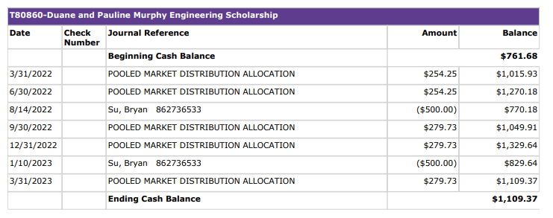
Projection Amounts - Endowed Funds
Projections for endowed funds include 4 quarters of earnings: June 2022, September 2022, December 2022 and March 2023.
If you base your budget by running a report from FIN, there may be a risk of overspending these accounts.
Be aware that any spending that happens in Spring 23 or Summer 23 after projections have been calculated will reduce the budget available for AY 23-24.
Projection amount for AY 22-23
4 quarters of earnings
Student received $500 Fall 22
$500 Spring 23
Projection amount
for AY 23-24

Slide 8
2023-2024 Projection Balances
Projection Spreadsheets
All Funds coded as Scholarships or Awards
Excellence funds are NOT included
KSUF Compliance have requested awarding budgets for Excellence funds to include in KSN
Projection spreadsheets are not updated as spending occurs
FIN (Foundation Information Network)
Use Caution
Amount in KSN represents your BUDGET

Slide 9
2023-2024 Awarding
Make selections between March-August based on:
Award amount and # of recipient guidelines in projections & KSN (1 recipient will receive $2,000 annually)
Criteria, per MOU
Projection Balances
SFA requesting award completion by June 30, 2023
Donor intent is the single most important factor when choosing recipients of Foundation funds.
Kansas Law Donor Intent Protection Act – Approved 4/19/2023
Provides enforcement of donor-imposed restrictions on philanthropic gifts to endowment funds.
If you feel awarding guidelines are unawardable, please reach out to KSUF Compliance staff: (KSN@ksufoundation.org)

Slide 10
Awarding in KSN
Scholarship awarding must take place in KSN
Encumber students in the correct opportunity
AcadYr beg 2023 = Academic year 2023-2024 or AY24
Awarding periods that apply: Fall 23, Fall 23/Spring 24, Spring 24 and Summer 24
AcadYr beg 2022 = Academic year 2022-2023 or AY23
Awarding periods that apply: Fall 22, Fall 22/Spring 23, Spring 23 and Summer 23
Encumbering in KSN:
Guarantees the student qualifies
KSN keeps track of the amount left to award
Download/upload process to KSIS (no errors)
Gratitude Statement Process
Encumbering categories
Pre-Accepted (Incoming Students)
Offered (Continuing Students)
Accepted
Force-Applying:
Student admitted after May 31st
Need

Slide 11
Confirmation KSN/KSIS Process
Admins can begin to submit award for AY24 now. Please send an email to Kris or Taylor that they can switch the aid year, as KSIS can only handle one aid year at a time.
KSN/KSIS Upload Process (demo)

Slide 12
KSN Tips and Tricks
Encumbering in mass (award amount and award period is the same)
Needing to split award between Fall and Spring unequally
Locating your appropriate opportunity when not presented in the search bar.

Slide 13
KSN Tips and Tricks continued
Portfolio and Opportunity Details Tab (Find Information section)
MOUs are uploaded in KSN
Considerations are criteria in the MOU that can’t be built as a qualification i.e. protected class.
Look at the MOU

Slide 14
Post-Acceptance/Gratitude Statement
Process
KSN
Merge/Edit
Mail
Scholarship Report (early November)
One off mailings
How can scholarship administrators help?
Encouraging students to complete
Autofill mention
Must hit submit
Encouraged to check each opportunity for relatable content
Questions?
Administrators can email heatherd@ksufoundation.org or call (785) 775-2031
Students can email scholarships@ksufoundation.org

Slide 15
Contacts
KSUF Staff
Email: KSN@ksufoundation.org
Email group: Anani, Katy and, Pam
Questions on:
MOUs/Qualifications
Projection balances
Help with encumbering
KSN Training
SFA Staff
Kris Shewmaker: kshewmaker@ksu.edu
Taylor Richter: trichte@ksu.edu
Questions on:
Reversing or changing awards
KSIS upload questions
Help with encumbering
KSN Training
Any other questions

Slide 16
Resources
Information on SFA’s website regarding KSN:
https://www.k-state.edu/sfa/scholarships-aid/scholarships/ksn/
Training videos: (Includes: 2022-2023 training and the KSN to KSIS Confirmation process)
https://www.youtube.com/playlist?list=PL2iHWZCTCJzFOwmW9yzD1Bw4RrHiORhL9
All KSN materials can be found at:
https://ksufoundation.org/accounting-forms/ Scroll down to the “K-State Scholarship Network (KSN)” section.
KSN Administrator instructions (PDF):
KSN-Scholarship-Administrators-Instructions.pdf (ksufoundation.org)

