Slide 1
Scholarship Admin Training Academic Year 2025-2026

Slide 2
Office of Student Financial Assistance
Vanessa Flipse, Associate Director for Scholarships
Taylor Richter, K-State Scholarship Network Coordinator
Notes:
SFA

Slide 3
KSU Foundation
Christy Scott, Associate Vice President of Compliance Services
Pam Collins, Director of Compliance Services
Anani Eble, Asst. Director of Donor Compliance Services
Katy Walradt, Asst. Director of Donor Compliance Services
Tony Webb, Donor Compliance Specialist
Natalee Jacobson, Donor Compliance Specialist
Notes:
SFA

Slide 4
Fund Types
Expendable funds
Not invested in endowment pool
Monies available for spending immediately
Endowed funds
Effective July 1, 2023, Minimum contribution of $50,000
Principal/corpus invested in endowment pool for perpetuity (cannot be invaded)
Percent (amount approved annually) of market value distributed for use by campus quarterly
Term-endowed funds
Principal/corpus invested in endowment pool
Principal can be invaded
Percent (determined by donor) or designated amount of market value distributed for use by campus quarterly
Notes:
CS

Slide 5
Protected Classes
Follow the University’s lead: Adhere to university policies and guidelines on protected classes.
Approximately 300 existing scholarship funds requiring superseding MOUs
ALL FUNDS FROZEN
UNTIL MOUs superseded
FUNDS are identified in your Scholarship Projection files
We will communicate when fund is superseded and money available
EXCEPTIONS-25/26 Awarding ONLY
US Citizen (or Permanent Resident)
Criteria Restrictions to Female/Male
Match Pool approach for 2025/2026
Criteria Language
Registered Student Organizations
Notes:
SFA/CS

Slide 6
KSUF MOUs
An MOU is a binding agreement that documents donor intent for a fund.
MOU and their supplemental documents, contain the information needed to:
Establish donor intent for awarding
Is used to build Qualifications in KSN
Which generates the opportunity’s applicant pool
Preferences:
Donor’s expectation that preferences are honored
If easily met, we build as a requirement (i.e., KS resident)
When there are no students who meet the preference, then fund can be awarded based on requirements only.
Notes:
CS

Slide 7
2025-2026 Projection Balances
In March
Donors have until March 1st to contribute to the expendable balance of their fund for Fall 25/Spring 26 awarding.
KSUF Accounting:
Finalizes March distributions (for endowed funds), receipts gifts through March, and adds the March earnings to a calculated income balance.
KSUF Compliance:
Reviews balances and prepares projection numbers.
Breaks out projection numbers by: College, Department and/Unit and sent spreadsheets by email (mid-March).
Loads balance information in KSN (K-State Scholarship Network).
Notes:
NJ

Slide 8
Projection Amounts - Endowed Funds
Projections for endowed funds include 4 quarters of earnings: June 2024, September 2024, December 2024 and March 2025.
If you base your budget by running a report from FIN, there may be a risk of overspending these accounts.
Be aware that any spending that happens in Spring 25 or Summer 25 after projections have been calculated will reduce the budget available for AY 25-26.
Notes:
NJ

Slide 9
2025-2026 Projection Balances
Projection Spreadsheets
All Funds coded as Scholarships or Awards
Excellence funds are NOT included
KSUF Compliance have requested awarding budgets for Excellence funds to include in KSN
Projection spreadsheets are not updated as spending occurs
FIN (Foundation Information Network)
Use Caution
Amount in KSN represents your BUDGET
Notes:
AE

Slide 10
2025-2026 Awarding
Make selections between March-August based on:
Award amount and # of recipient guidelines in projections & KSN (For example, 1 recipient will receive $2,000 annually)
Criteria, per MOU
Projection Balances
Donor intent is the single most important factor when choosing recipients of Foundation funds.
If you feel awarding guidelines are not awardable, please reach out to KSUF Compliance staff: (donorcompliance@ksufoundation.org)
Notes:
AE

Slide 11
Awarding Timeline 2025-2026
Key Dates:
12/1/24 – College/Department priority deadline for freshmen. College/depts offering awards to new incoming freshmen, upload placeholder award to KSIS.
1/15/25 – University priority application deadline for in-state students
2/1/25 – University priority application deadline for out-of-state students
2/1/25 – KSN priority application dates for incoming freshmen
3/15/25 – Begin offering scholarships to continuing students
5/15/25 – Spring 2025 Grades Post
5/30/25 – KSN General/College applications close for 2025/2026
6/6/25 – Deadline for Scholarship Administrators to upload CSV file for SFA
6/20/25 – Goal date for SFA to finalize awards in KSIS to be reflected on student bill
6/27/25 – Campus encumbers and submits placeholder funding source to SFA for incoming students if applicable
7/3/25 – Deadline for SFA to adjust student aid packages with new scholarships added prior to Fall 25 tuition assessment.
7/15/25 – Tuition billing available to students
9/30/25 – Final Opportunity Balance for 85% awarding
Notes:
SFA (TR)

Slide 12
Awarding in KSN
Scholarship awarding must take place in KSN
Encumber students in the correct opportunity
AcadYr beg 2025 = Academic year 2025-2026 or AY26
Awarding periods that apply: Fall 25, Fall 25/Spring 26, Spring 26 and Summer 26
AcadYr beg 2026 = Academic year 2026-2027 or AY27
Awarding periods that apply: Fall 26, Fall 26/Spring 27, Spring 27 and Summer 27
Encumbering in KSN:
Guarantees the student qualifies
Offered category no longer being used
KSN keeps track of the amount left to award
Download/upload process to KSIS (no errors)
Gratitude Statement Process
Notes:
TR/AE

Slide 13
Awarding upload process
Administrators can begin to submit awards for AY26 now.
Notify SFA/Taylor Richter
Streamline upload process.
Recording of the new process is integrated into the KSN – Scholarship Administrators Training Video.
All awards must be encumbered in KSN.
Notes:
TR/AE

Slide 14
KSN Tips and Tricks
Encumbering in mass (award amount and award period is the same)
Needing to split award between Fall and Spring unequally
Locating your appropriate opportunity when not presented in the search bar.
Reasons students may not be in the pool:
Students may not qualify.
Late admit students driven by opportunity dates.
Example: Opportunities closed on May 30 and a student is admitted after this date – they will need to be force-applied into the current opportunity.
Need (FAFSA=No, Financial need statement=No).
College major change, etc.
Notes:
TR/AE

Slide 15
KSN Tips and Tricks continued
Portfolio and Opportunity Details Tab (Fund Information section)
MOUs are uploaded in KSN
Considerations are criteria in the MOU that can’t be built as a qualification i.e. protected class.
Look at the MOU
Notes:
TR/AE

Slide 16
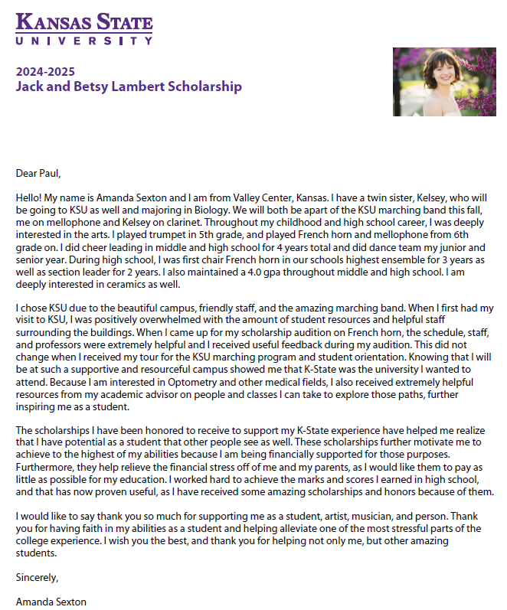
Post-Acceptance | Gratitude Statements
KSU Foundation manages thank yous for ALL funds.
Post-Acceptance Notification:
Triggered upon “accepted” category, students receive an e-mail and will see it on their KSN dashboard. Regular reminders are also sent.
Processing:
KSU Foundation merges and proofs student responses into template.
Donors receive letters throughout the academic year and an annual recipient report is sent to donors in May.
How can scholarship administrators help?
Communication:
Inform students they’ll be prompted to fill out post-acceptance forms. Gratitude statements can’t be processed unless the student hits “submit”.
Autofill option:
Students with multiple scholarships can autofill answers. Specific information on a fund will be copied to all scholarships. Encourage students to double-check and edit as needed.
Questions?
Administrators: E-mail daniellec@ksufoundation.org or call (785) 775-2038
Students: E-mail scholarships@found.ksu.edu
Notes:
Session 1: Dee/AE
Session 2: DC/AE

Slide 17
New awarding management system
More to come!
Notes:
SFA

Slide 18
Contacts
SFA Staff
Taylor Richter: trichte@ksu.edu
Vanessa Flipse: vanessas@ksu.edu
Questions on:
KSN/KSIS related questions including training.
Both SFA and KSUF will continue to collaborate.
KSUF Staff
Email: donorcompliance@ksufoundation.org
Questions on:
MOUs/Qualifications
Projection balances
Notes:
TR

Slide 19
Resources
Information on SFA’s website regarding KSN:
https://www.k-state.edu/sfa/scholarships-aid/scholarships/ksn/
Scholarship Administrator Training videos including Awarding Upload process
https://www.youtube.com/playlist?list=PL2iHWZCTCJzFOwmW9yzD1Bw4RrHiORhL9
All KSN materials can be found at:
SFA: https://www.k-state.edu/sfa/internal/scholarship-upload/
KSUF: https://ksufoundation.org/accounting-forms/ Scroll down to the “K-State Scholarship Network (KSN)” section.
KSN Administrator instructions (PDF):
KSN-Scholarship-Administrators-Instructions.pdf (ksufoundation.org)
Training powerpoint will be available post training.
Notes:
SFA/TR

Slide 20
Questions

