Slide 1
Scholarship Admin Training Academic Year 2026-2027

Slide 2
Office of Student Financial Assistance Vanessa Flipse, Associate Director of Scholarships Ryan Hernandez, K-State Scholarship Network Coordinator

Slide 3
KSU Foundation Katy Walradt, Director of Compliance Pam Collins, Director of Fund Administration Anani Eble, Assistant Director of Compliance Natalee Jacobson, Donor Compliance Manager Tony Webb, Donor Compliance Specialist Jen Schroeder, Donor Compliance Specialist

Slide 4
Fund Types
Expendable funds
Not invested in endowment pool
Monies available for spending immediately
Endowed funds
Effective July 1, 2023, Minimum contribution of $50,000
Principal/corpus invested in endowment pool for perpetuity (cannot be invaded)
Distributions are received quarterly and are a percentage of endowment pool’s market value
Term-endowed funds
Principal/corpus invested in endowment pool
Principal can be invaded
Percent (determined by donor) or designated amount of market value distributed for use by campus quarterly

Slide 5
Protected Classes
The majority of MOUs have been superseded to remove protected class language.
If the protected class language has not been finalized, then the scholarship will be available in KSN with a $0 balance.
Communication has been sent to respective unit if this applies to you.
Existing MOUs using registered organizations
No new MOUs with protected class categories language.

Slide 6
KSUF MOUs
An MOU is a binding agreement that documents donor intent for a fund.
MOU and supplemental documents contain the information needed to:
Establish donor intent for awarding
Build Qualifications in KSN
Generate the opportunity’s applicant pool
Preferences:
Donor’s expectation that preferences are honored
If easily met, we build as a requirement (i.e., KS resident)
When there are no students who meet the preference, then fund can be awarded based on requirements only.
New MOUs are not written with preferences.

Slide 7
2026-2027 Projection Balances
Donors have until March 1st to contribute to the expendable balance of their fund for the upcoming academic year.
KSUF Accounting:
Finalizes March distributions (for endowed funds), receipts gifts, and adds the March earnings to a calculated income balance.
KSUF Compliance:
Reviews balances and prepares projection numbers.
Breaks out projection numbers by: College, Department and/Unit and sends spreadsheets by email (mid-March).
Loads balances to KSN (K-State Scholarship Network).

Slide 8
2026-2027 Projection Balances
Projection Spreadsheets
All Funds coded as Scholarships or Awards
Excellence funds are NOT included
Projection spreadsheets are not updated as spending occurs
Additional analysis to take place in June to identify awarding after projections were sent.
FIN (Foundation Information Network)
Use Caution
Amount in KSN represents your BUDGET

Slide 9
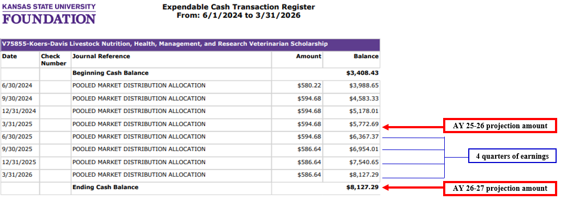
Projection Amounts - Endowed Funds
Projections for endowed funds include 4 quarters of earnings: June 2025, September 2025, December 2025 and March 2026.
If you base your budget by running a report from FIN, there may be a risk of overspending.
Be aware that any spending that happens in Spring 26 or Summer 26 after projections have been calculated will reduce the budget available for AY 26-27.

Slide 10
2026-2027 Awarding
Make selections between March-August based on:
Award amount and # of recipient guidelines in projections & KSN (For example, 1 recipient will receive $2,000 annually)
Criteria, per MOU
Projection Balances
Donor intent is the single most important factor when choosing recipients of Foundation funds.
If you feel awarding guidelines are not awardable, please reach out to KSUF Compliance staff: (complianceservices@ksufoundation.org)

Slide 11
Awarding Timeline 2026-2027
Key Dates:
12/1/25 — College/Department priority deadline for freshmen; college/depts offering awards to new incoming freshmen, upload placeholder award to KSIS.
2/1/26 — University priority application deadline for incoming freshmen
2/1/26 — KSN priority application date for incoming freshmen
3/15/26 — KSN priority application date for incoming transfer/graduate/international students and continuing students
3/15/26 — Begin offering scholarships to continuing students
5/1/26 — University priority application deadline for incoming transfer students
5/20/26 — Spring 2026 Grades Post
6/5/26 — Deadline for Scholarship Administrators to upload CSV file for SFA
6/12/26 — Goal date for SFA to finalize awards in KSIS to be reflected on student bill
6/17/26 — Campus encumbers and submits placeholder funding source to SFA for incoming students if applicable
6/24/26 — Deadline for SFA to adjust student aid packages with new scholarships added prior to Fall 26 tuition assessment.
6/30/26 — KSN General/College applications close for 2026/2027
7/6/26 — Tuition billing available to students
2026-2027 Spending goal is 90%

Slide 12
Awarding in KSN
Scholarship awarding must take place in KSN
Encumber students in the correct opportunity
AcadYr beg 2026 (KSN) = Academic year 2026-2027 or AY27 (KSIS)
Awarding periods that apply: Fall 26, Fall 26/Spring 27, Spring 27 and Summer 27
Importance for Encumbering in KSN:
Assist with analyzing the spending goal of 90% for 2026-2027
Guarantees the student qualifies
KSN keeps track of the amount left to award
Download/upload process to KSIS (no errors)
Gratitude Statement Process
Awarding amounts: the goal is for awards to be impactful.

Slide 13
Awarding upload process
Administrators can begin to submit awards for AY27 now.
Notify SFA (Ryan Hernandez and Vanessa Flipse).
Awards can still be submitted for AY26.
Streamline upload process.
Recording of the new process is integrated into the KSN – Scholarship Administrators Training Video.
All awards MUST be encumbered in KSN prior to submitting award files to SFA.

Slide 14
KSN Tips and Tricks
Encumbering in mass (award amount and award period must be the same)
Grid views
Needing to split award between Fall and Spring unequally
Locating your appropriate opportunity when not presented in the search bar.
Reasons students may not be in the pool:
Students may not qualify.
Late admit students driven by opportunity dates.
Example: Opportunities closed on June 30 and a student is admitted after this date – they will need to be force-applied into the current opportunity.
Need (FAFSA=No, Financial need statement=No). Students can still be forced applied. The ultimate decision is up to the University.
College major change, etc.

Slide 15
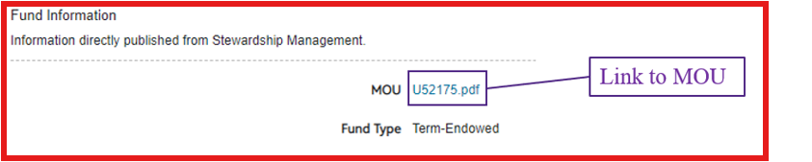
KSN Tips and Tricks continued
Portfolio and Opportunity Details Tab (Fund Information section)
MOUs are uploaded in KSN
Considerations are criteria in the MOU that can’t be built as a qualification i.e. protected class.
Look at the MOU

Slide 16
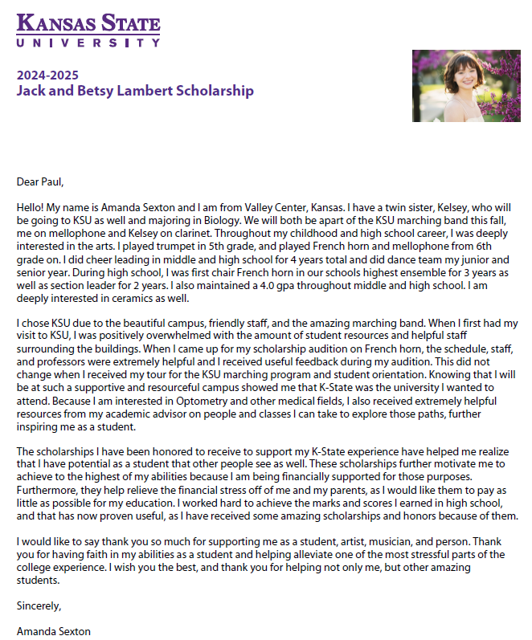
Post-Acceptance | Thank You Letters
KSU Foundation manages thank-yous for ALL funds.
Post-Acceptance Notification:
Triggered upon “accepted” category, students receive an e-mail and will see it on their KSN dashboard. Regular reminders are also sent.
Processing:
KSU Foundation merges and proofs student responses into template.
Donors receive letters throughout the academic year, and an annual recipient report is sent to donors in May.
How can scholarship administrators help?
Communication:
Inform students they’ll be prompted to fill out post-acceptance forms. Thank-you letters can’t be processed unless the student hits “submit”.
Autofill option:
Students with multiple scholarships can autofill answers. Specific information on a fund will be copied to all scholarships. Encourage students to double-check and edit as needed.
Questions?
Administrators: E-mail deandraw@ksufoundation.org or call (785) 775-2031
Students: E-mail scholarships@ksufoundation.org

Slide 17
New awarding management system
Timeline
3/16/26 — Next-Gen (NG) scholarship manager implementation begins
4/1/26 — Review of college-specific/conditional KSN applications due
7/21/26 — Scholarship Admin training in NG begins
8/18/26 — NG scholarship manager goes live
Blackbaud Award Management contract ends on February 7, 2027.
2/1/27 — Deadline for college/depts to encumber all AY26/AcadYr beg 2026 awards in KSN

Slide 18
Contacts
SFA Staff
Vanessa Flipse: vanessas@ksu.edu
Ryan Hernandez rhernan@ksu.edu
Questions on:
KSN/KSIS related questions including training.
Both SFA and KSUF will continue to collaborate.
KSUF Staff
Email:
complianceservices@ksufoundation.org
Questions on:
MOUs/Qualifications
Projection balances
Spending goal or analysis
Negative balances

Slide 19
Resources
Information on SFA’s website regarding KSN:
https://www.k-state.edu/sfa/scholarships-aid/scholarships/ksn/
Scholarship Administrator Training videos including Awarding Upload process
https://www.youtube.com/playlist?list=PL2iHWZCTCJzFOwmW9yzD1Bw4RrHiORhL9
All KSN materials can be found at:
SFA: https://www.k-state.edu/sfa/internal/scholarship-upload/ (link was removed, asked IT to restore 3/16/26)
KSUF: https://ksufoundation.org/accounting-forms/ Scroll down to the “K-State Scholarship Network (KSN)” section.
KSN Administrator instructions (PDF):
KSN-Scholarship-Administrators-Instructions.pdf (ksufoundation.org)
Training powerpoint will be available post training.

Slide 20
Questions

